Slide 1


Welcome Coaches to AYSO REGION 60
Region 60’s Coach Admin (RCA): Matthew Chavez
  matt@ayso60.org
Coach Mentor: Dalila Muro
  dalila@ayso60.org
Coach Equipment Coordinator: Cindy Au-Yeung
  cindy@ayso60.org

Slide 2
Steps to Become a Coach
Steps to Volunteer: https://www.ayso60.org/Default.aspx?tabid=963327
Volunteer approval is needed on an annual basis
Risk Status/Background Check (annually 15-20 min)
Live Scan/Fingerprints (1-time)
Safe Haven Training Certification (1-time/ 15-20 min)
Concussion Training Certification (1-time/ 15-20 min)
Sudden Cardiac Arrest Training Certification (1-time/ 15-20 min)
Safe Sport Training Certification
  90 minutes for first time
  30 minutes every year afterwards
Coach Certification for the specific division (1-time)

Slide 3
Coach Resources
AYSO 60 Coach Page: https://www.ayso60.org/Default.aspx?tabid=854956
  Coaches
    Volunteer Requirements, Coach Divisions, Cross Certification from USSF and Coach Job Description
  Steps to Become a Coach
    Coach Volunteer Process
  Coaching Support
    2025 Coach’s Presentation (Old…Will Post Soon)
    School Yard Program (FMS) Weeks 1 – 10
    Defending 1v1
    50 Dribbling Skills
  Heading the Ball
  Coaching Resources
    AYSO Coaching Resources
    Line-up Card (Old…Working on New One)
    Concussion Action Plan
    AYSO Participant (Return to Play) Release
  Incident Report
    Player or Volunteer Injured during AYSO Events (Practice, Game)
    Player Injuries for non AYSO events please keep a copy of doctor’s note
    Complete AYSO Participant (Return to Play) Release
      Needed for Player to Return to Play
eTrainU:
  After logging-in to your ayso60 account select “AYSOU” and the page will direct you to eTrainU
  Go to Resource Library/Coach Manuals

Slide 4
Coach Responsibilities
AYSO 60 Coach Job Description: https://dt5602vnjxv0c.cloudfront.net/portals/14654/docs/volunteers/volunteer_coach%20job%20description.pdf
  Develop Players
  Be a Good Role Model
  Promote AYSO Philosophy (Everyone Plays, Balanced Teams, Positive Coaching, Good Sportsmanship, Player Development)
    All Coaches should leave Team Formations feeling confident all the Teams are Balanced
    Transparency
  Support Chain of Command (Respective DC, RCA or RRA and RC)
  Know your Division Commissioner!
    SY: Christina Martin
    8UB: Kristy Rowe & 8UG: Jay Yao
    10UB/G: Jim Jaime
    12UB: Jesus Para & 12UG: Jim Jaime and Christina Bentivegna
    14UB: Ryan Medrano & 14UG: Jesus Chavez
    UD: Alex Gilbert
    Include them on email traffic affecting their division
    Contact them with Questions or Concerns
    Issues with Parents or anything let us know by brining it up
  Contact Parents
    Conduct Parent Meeting (Parent Orientation)
    Make 100% contact for each parent. If someone doesn’t respond, inform DC ASAP
    Confirm if any player has allergies, asthma or any medical condition you should be aware of

Slide 5
Coach Responsibilities (Cont.)
  Head Coach Set Practice Schedule
    Days, Times & Locations within our permits. Minimum 1 practice per week for 1 hour
  Always Carry Roster & Medical/Player Release Forms
  First Aid Kit
  Assistant Coach will ASSIST the Head Coach as directed by offering input
    If any issues please inform DC, RCA & RC
  Carry out Team Tasks (Utilize your Team Manager for Team Communication)
  Share Grid Space with other Coaches
  Responsible for players during team activities (e.g., practices, games) until a duly designated adult has taken charge of each child
  Have FUN!

Slide 6
Coach Courses (etrainu)
Course | Available Online | Field Session Required | Online Pre-Course Required
Playground/Schoolyard Soccer Program Leader | YES | NO | NO
6U Coach | YES | NO | NO
8U Coach | YES | NO | NO
10U Coach | YES | YES | NO
* 12U Coach * | YES | YES | YES
Intermediate Coach | YES | YES | YES
Advanced Coach | YES | YES | YES

Slide 7
Register for a Coach Course (etrainu)
Login to your AYSO 60 account
Go to Volunteer Tab
Select “AYSOU” and the page will direct you to eTrainU
Click on the options tab and go to “Training Event”
Under Courses in Search Fields search for the course you want to take
After finding the correct course select “Enroll” and wait for an email. You can also reach out to the course contact that is listed directly
Please read all the course information & complete all Prerequisites before attending course

Slide 8
Game Day Procedures
First Game of Day Normally Starts @ 8am
First Game Teams Responsible putting UP Goals
  Goal Building Instructional Video
    https://youtu.be/b9vcg95kiZA?feature=shared
Last Game Teams Responsible putting AWAY Goals
Pick-Up Game Cards at Referee Tent (Reference Slide 10)
  Completed Game Cards will be handed out for those that provided Game Card Template
  Send to jill@ayso60.org, alex@ayso60.org and matt@ayso60.org
  If Game Card Template wasn’t emailed then Blank Game Card will be provided
  Every week Game Cards will be provided at the Referee Tent
Have your team arrive minimum 30 min before game time
Home Team will sit on North/West Touchline & Away Team South/East Touchline
Don’t run up Score over a 6 goal differential
  It’s NOT JUST ABOUT WINNING!

Slide 9
Game Day Procedures (Cont.)
Same Like Practice
  Players No Jewelry
  Shin Guards
    NO MINI SHIN GUARDS
  Any Incidents inform your DC and/or Board Member ASAP
Control Sideline Behavior
  Parents Cheer and Coaches Coach
  Zero Tolerance for Referee Abuse
  Be Respectful towards Referees
  Be a Good Example for the Kids
Only Board Members are Allowed in Bins
Have Parents clean-up your sideline trash
Refrain from using Foul Language
NO Coach Score Submission will be implemented this season

Slide 10
Coach Game Cards
Game Cards w/ QR Code
  Will be printed week by week
  Coach will need to pick them up at the Ref Tent before each game
  The QR Code on the Back of the Game Card is for the Referees
Email the following information to: jill@ayso60.org, alex@ayso60.org and matt@ayso60.org
  Division (Boy/Girl)
  Team Name
  Head Coach Full Name
  Assistant Coach Full Name
  Players Full Name with assigned Jersey Number
  Only Fully Cleared/Certified Volunteers will be added
  If you don’t provide above information you have to manually fill out your game cards
  The only acceptable game cards are the ones we provide

Slide 11
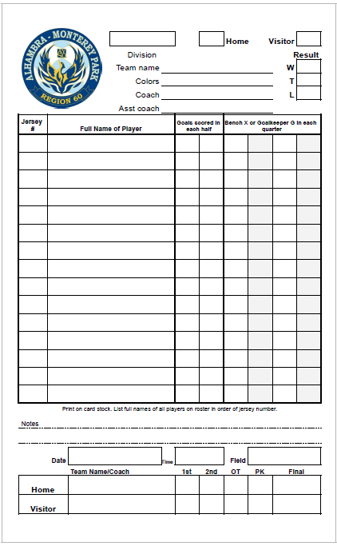
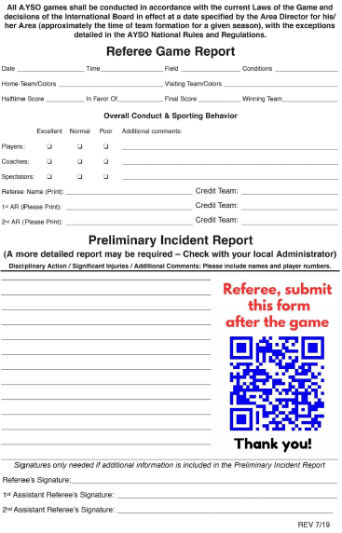
Coach Game Cards

Slide 12
Coach Training w/ RCA (Optional)
Past Sessions
  August 16 at Almansor
    How to Run a Practice (Dynamic Stretching, Footwork, Skills, Dribbling, Passing, Shooting, Small Sided Scrimmages & Formations)
Future 1-on-1 Sessions
  Sep 8, Sep 15 & Sep 29 (Reserved)
  Sep 22 & Oct 6 (Open Dates)
    Coach recommendation on what to go over

Slide 13
Training Help & Key Words
5 Attacking/Defending Principles
  Penetrate/Delay, Support/Depth, Width/Concentration, Mobility/Balance, Creativity/Composure
Players Make the Right Decisions
Ready Position
First Touch
Vision
Try to keep Ball Moving
Have an idea to go with Ball before receiving
Key Words
  Check-Out & Check-In
  Check Shoulder
  Face the Field
  Pass Away from Pressure
  Pass where you face
  Switch Field
  Look Forward
  Sometime you have to Pass Back to Go Forward

Slide 14
Q & A

